Slide 1
CIS150 - Introduction
Prof. Steve Kendra

Slide 2
Today’s Agenda
Course Administration
  Course website (Blackboard)
    https://blackboard.louisville.edu/webapps/login
  Syllabus and Schedule
    BB > Course Information (where BB = Blackboard)
  Meet Your Professor
    BB > Course Information
Course Introduction
    BB > Course Documents
  What are Information Systems?
  Benefits of I.S.
  Risks and Controversies

Slide 3
What are Information Systems?

Slide 4
The Purpose of IS
Help people solve problems and make decisions
  requires information
Keys to success in business are:
  Input (collect and organize relevant data)
    transaction (the foundation of an organization) – a business event, usually entered as input
  Data processing (perform calculations on input)
  Output (producing information)
  Storage (vast amounts of data/information stored)

Slide 5
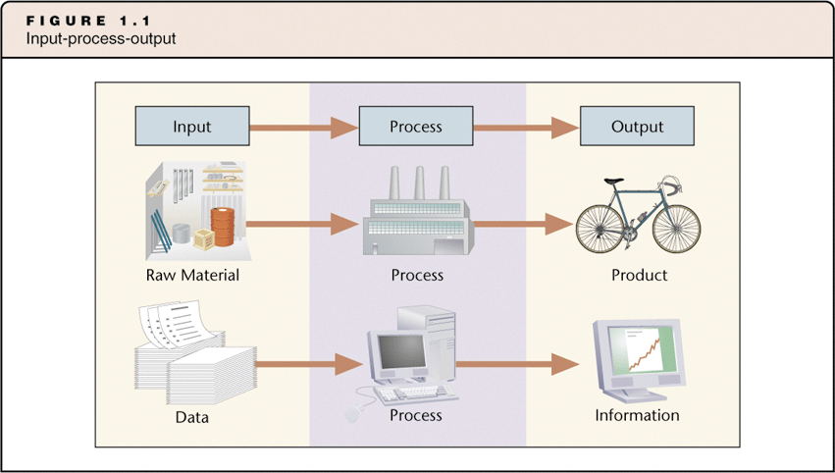
Generating Information

Slide 6
Generating Information
Data
  A given or fact
  Can be a number, statement, or picture
Process
  A manipulation of data
  Can be addition, multiplication
  Can be an algorithm that matches customers to products
Information
  Facts or conclusions that have meaning within context
Example
  What is the average age of students in this class?

Slide 7
Generating Information
(more examples)
What products will Matt Thatcher want to purchase from e-commerce sites ?
(e.g., Amazon.com, Travelocity.com)
  Data?
  Process?
  Information?
  What decisions does Amazon.com make based on this information?

Slide 8
Generating Information
(more examples)
What about online dating sites?
(e.g., match.com, eharmony.com)
  Data? Process? Information? What decisions are made?
What about retail stores or grocery stores?
(e.g., Kroger’s, Smith’s, Walmart)
  Data? Process? Information? What decisions are made?
What about casinos?
(e.g., Caesar’s Palace, The Venetian)
  Data? Process? Information? What decisions are made?

Slide 9
What Is a System?
System
  Set of components that work together to achieve a goal or goals
  Accepts input, processes input, and produces output
A system may:
  Have multiple goals (think about an organization as a system)
  Contain subsystems (think about Finance, Accounting, Marketing, etc.)
Subsystems:
  Have sub-goals that meet the main goal
    What are the goals of Accounting? Finance? Marketing? Logistics?
  Transfer output to other subsystems
    How do these subsystems communicate and collaborate? IS automates much of this process!

Slide 10
What is an Information System?
An Information System (IS) is group of components that interact to produce information
  Collects and organizes data
  Processes/analyzes the data
  Produces information
    Problem-solving
    Decision-making

Slide 11
Benefits of IS

Slide 12
New Opportunities
Moore’s Law
  Price/performance ratio of computers has fallen dramatically
    Computers are smaller
    Computers are less expensive
    It is the reason why the IS are so common!
  Drives the new IS opportunities!!
Free data storage, data communication, and free data transmission

Slide 13
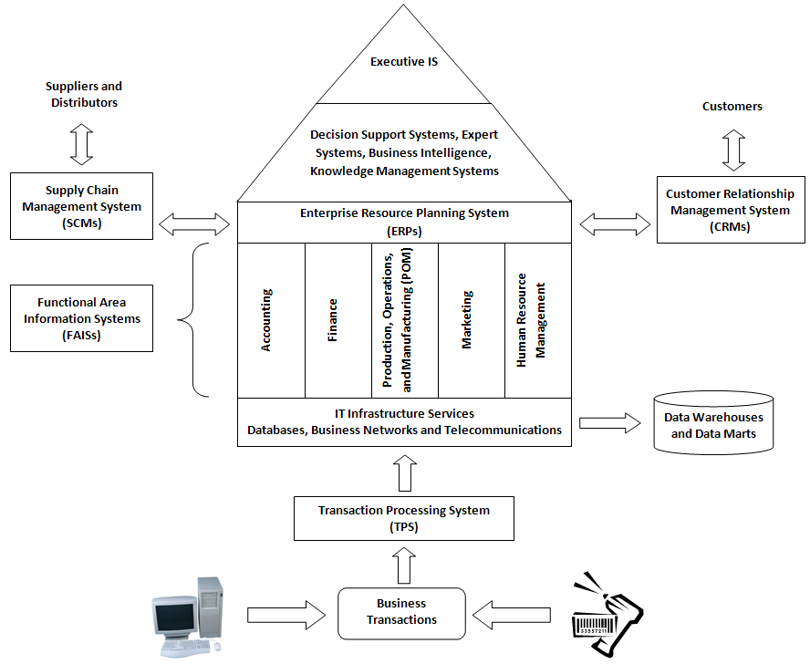
What Are the Benefits of IS?
(Business Applications)
Business Applications (focus of CIS 300)
  Word processors, spreadsheets, organizational IS, biometrics, etc.

Slide 14
What Are the Benefits of IS?
(Internet Applications)
Electronic Commerce
Amateur creative works
  Blogs, video, audio
Connections
  Internet telephony (skype.com), email, cell phones
  Social Networks (YouTube, Facebook, MySpace, on-line dating)
    Cheap, powerful technology now enables an unprecedented level of connectivity among people
  Telemedicine
  Distance learning, distance education
Collaboration among strangers
  Wikis

Slide 15
What Are the Benefits of IS?
(Collaboration)
Collaboration
  Two or more people
  Working together
  Toward a common goal, result, or product
  Often over great distances
Teams use information systems to facilitate collaboration
  Communication
  Sharing resources

Slide 16
What Are the Benefits of IS?
(Collaboration: Written Communications)
E-mail
  Electronic messaging through the Internet
IM
  Instant messaging through mobile devices
Blogs
  Electronic logs maintained on the Internet (weblogs)
Wikis
  Common knowledge base maintained by users
  Store and publish group’s knowledge
  http://wikipedia.org
Team portals
  Web site that publishes information about team’s activity
  Schedules, tasks information, calendars

Slide 17
Instant Messaging
Instant messaging (IM)
  Real-time chat
  Form of synchronized e-mail
  Chat room
    Communicate with a group
  Free applications for IM include:
    AIM: AOL instant Messenger
    Yahoo Messenger
    MSN Messenger
  Business uses
    Customers can chat with sales or support reps

Slide 18
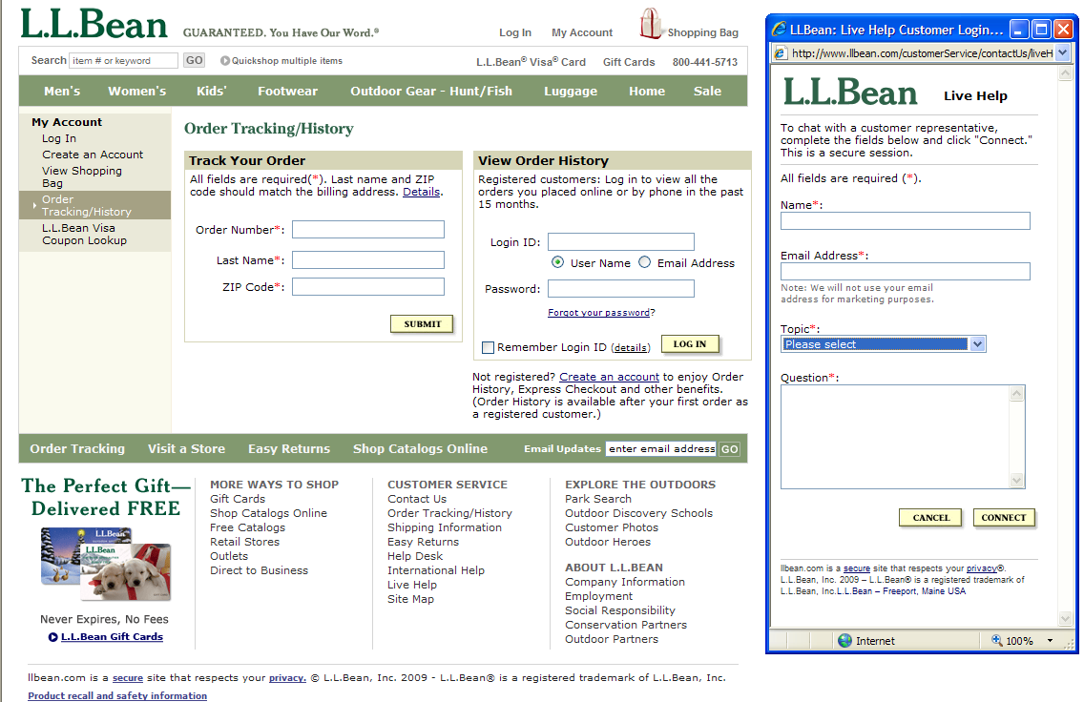

Slide 19
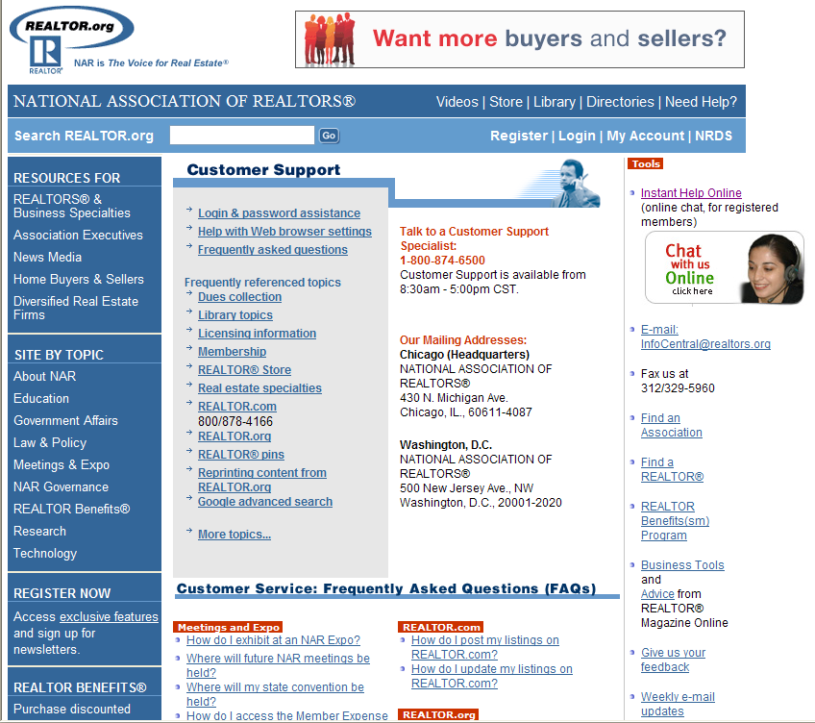

Slide 20
Wikis
Wiki (from Hawaiian word meaning “quick”)
  Web application that enables users to add to and edit the contents of Web pages
  All the software required to edit the Web pages is embedded in the pages themselves
Wikipedia
  a popular online encyclopedia
  http://wikipedia.org
Wiki technology is a popular ingredient in groupware (software used for collaboration)

Slide 21

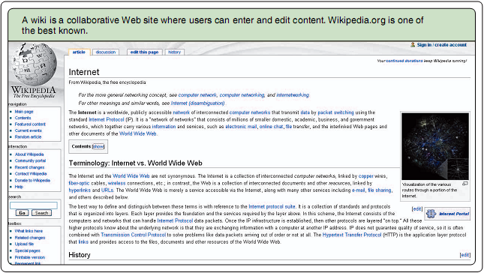
Wikipedia
(Example)

Slide 22
Blogs
Contraction of “Web log”
  Personal website, open to the public, in which the site creator expresses his or her feeling, opinions, information, or whatever the creator wants
  Invites surfers to post opinions and art
  Focuses on a topic or set of topics
  Blogosphere
    Term for the millions of blogs on the Web
Types of Blogs
  Corporate blogs
  CEO blogs
    http://boeingblogs.com/randy (Randy Tinseth, VP marketing)
  Industry blogs
  Department/Product blogs
  Customer Service Blogs
  Others (more personal stuff)
    http://www.jaredwsmith.com/blog

Slide 23
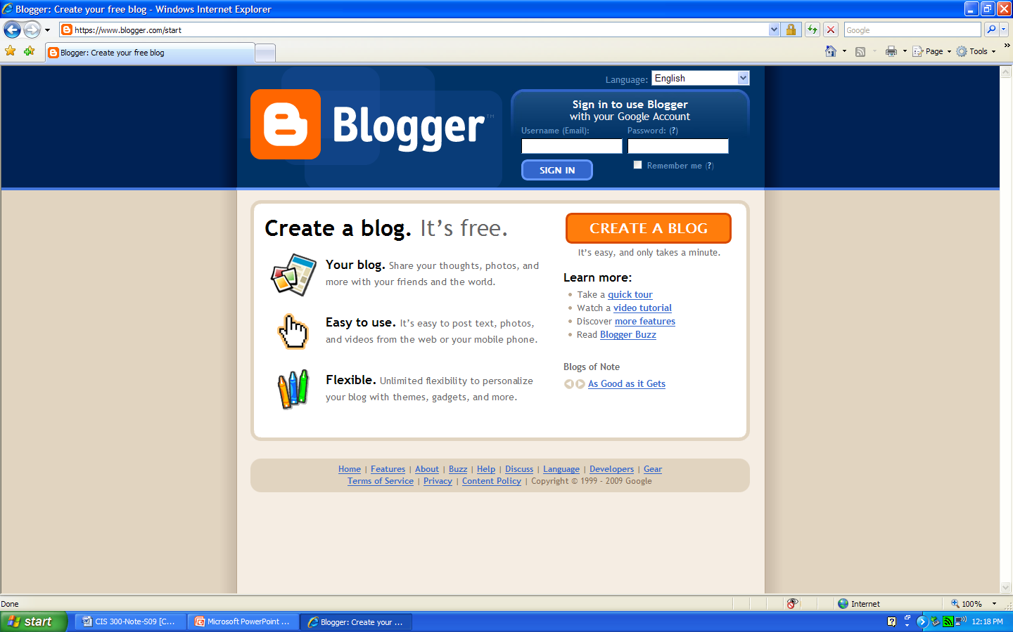
Creating a Blog
(www.blogger.com)

Slide 24
Blogs
(Examples)
Corporate Blogs
  Find out what blog participants think and say about the organization
  Often blogs about products, services, and customers
    http://googleblog.blogspot.com (Google)
    http://blogs.adobe.com (Adobe)
    http://blog.facebook.com (Facebook)
    http://direct2dell.com/one2one (Dell)
Nice article on the Top 15 Corporate Blogs
  http://mariosundar.wordpress.com/2008/05/05/top-15-corporate-blogs-ranked-may-2008

Slide 25
What Are the Benefits of IS?
(Collaboration: Verbal Communications)
Cellular Phones
VoIP
  Voice over IP (Internet Protocol)
    Providers include www.vonage.com and www.skype.com
  Communications over the Internet
  Digital
    Can be saved
    Sent as attachments
    Turned into podcasts
Podcasts
  Digital files
  Can be downloaded and played

Slide 26
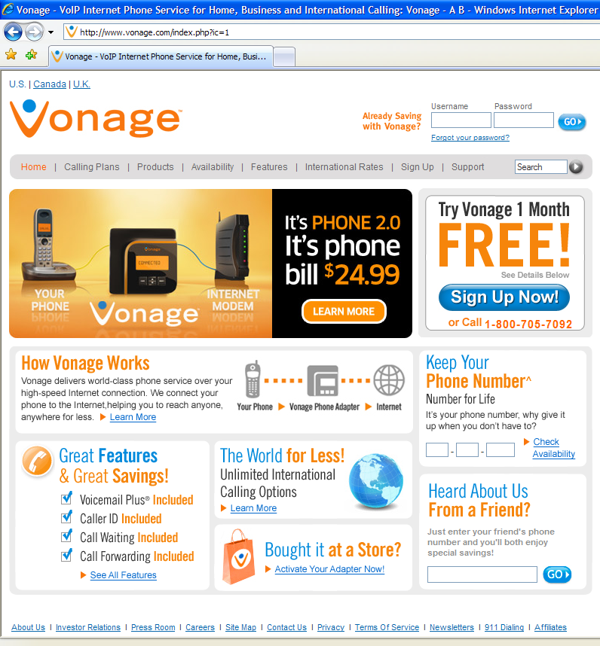
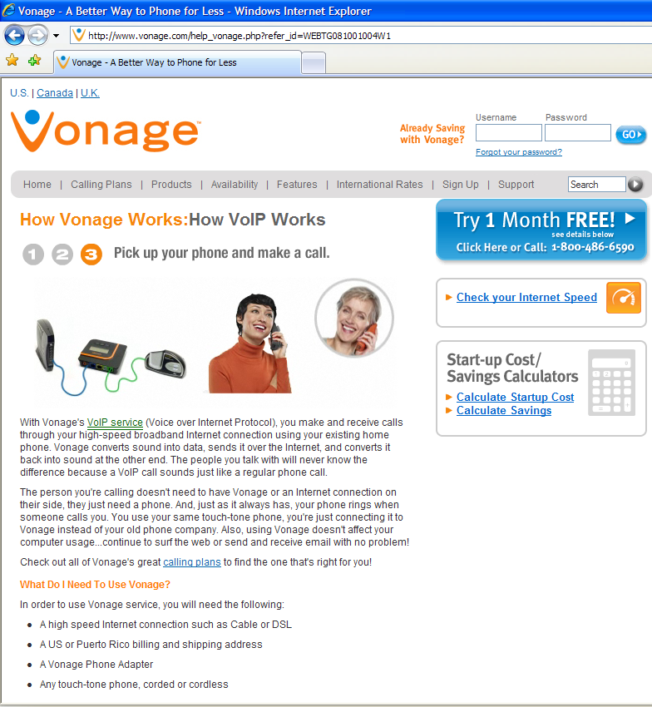
VoIP
(www.vonage.com)

Slide 27
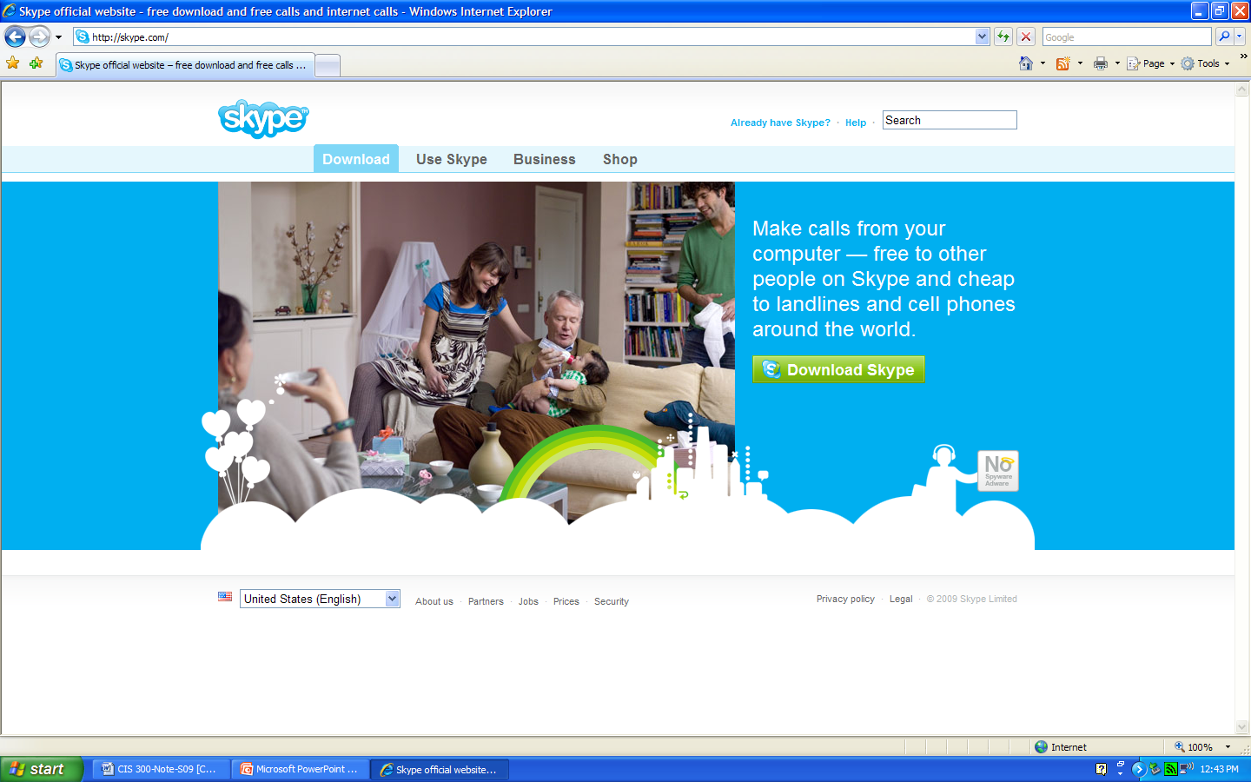
VoIP
(www.skype.com)

Slide 28
Podcasting
Podcast
  Publishing sound and video on the Web for download
  Usually on a subscription basis (RSS Feed)
Uses include:
  “Time-shifted” broadcast of radio station programs for later listening
  Audio tours in museums
  Lectures in distance learning courses
  www.garageband.com
    Allows aspiring musicians to post music tracks

Slide 29
What Are the Benefits of IS?
(Collaboration: Meeting Support)
Conference calls
  Several people connected in one phone call
Video conferencing
  Conference call with video camera
Net meeting
  Proprietary product that produces video conference
WebEx
  Moderated conference call
Webcast
  Meeting broadcast over the Internet

Slide 30
What Are the Benefits of IS?
(Other Applications)
Computer games
Digital technologies
  Movies, TV, music, library retrieval
Automobiles and trucks
Education and training
  On-line courses (University of Phoenix)
  On-line course support (Blackboard, Tegrity)
  On-line traffic school
Crime fighting
Health care
Tools for people with disabilities

Slide 31
What are the Risks and Controversies Associated with IS?

Slide 32
What are the Problems, Risks, and
Controversies with IT?
Information Privacy
  consumer privacy vs. access to information
  workplace privacy vs. access to information
  civil liberties vs. law enforcement
Freedom of speech vs. control of content on the internet
  on-line pornography, on-line gambling, cyber-bullying
Intellectual property rights
Computer security and computer crimes
IT safety and reliability vs. fast market entry

Slide 33
How Do We Examine These IT Issues?
What?
  What is the description of what is happening?
  What new technology is being implemented in what context?
So what?
  What are the benefits of the IT and the concerns and problems introduced by the IT?
  What are the different perspectives in the context?
Now what?
  What are the potential solutions to the problem?

Slide 34
ATMs: A Simple Example
What are the benefits of ATMs?
What are the negative aspects of ATMs?
  Unemployment
  Lower levels of customer service
  Crime
  Loss of privacy
  Errors
Does this mean that ATMs are bad?
How can we manage and minimize the problems?
What are some potential solutions?

Slide 35
Summary
Computers are ubiquitous
  They help people solve problems and make decisions
Some questions you should be able to answer
  What is a system?
  What is an information system?
  What is the purpose of an I.S.?
  What are examples of some common I.S.?
  What new opportunities for I.S. are developing today and what is driving these new opportunities?
  What are some key ethical dilemmas created by IS?

